Slide 1

Liam Myhill Ph.D. Student
Material Design: Strength by Diversity
Dr. Enrique Martinez Saez Department of Mechanical Engineering

Slide 2
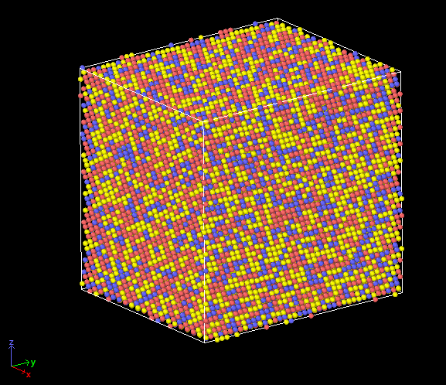
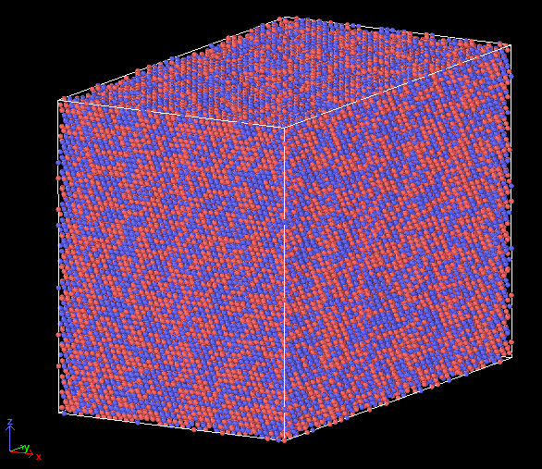
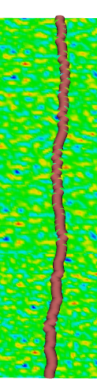
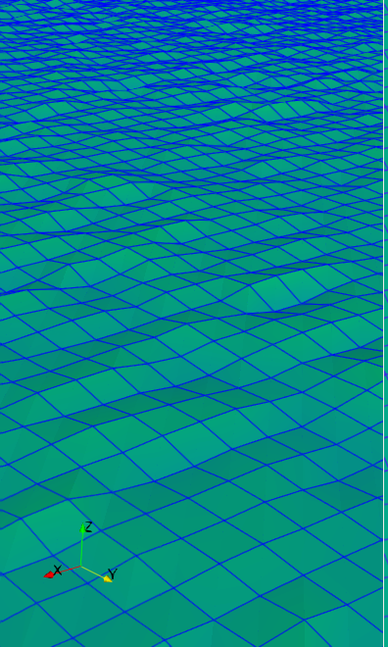







How much of the material design space have we explored?
FCC $Al_{50}Mg_{50}$
BCC $Mo_{33}Nb_{33}Ti_{33}$
Traditional Alloy
Multi-Principal Element
Alloy
B
B
B
D
B
B
D
B
A
A
B
B
C
B
B
B
B
C
How does composition diversity improve material performance?
Line defect pinned by obstacles arising from composition diversity
Stress fluctuations arising from composition diversity
BCC $Mo_{33}Nb_{33}Ti_{33}$
Why should you care?
“In diversity there is beauty and there is strength”
-Maya Angelou
Notes:
Traditional engineering metals have leveraged the properties of a single base element and tried to improve upon those properties by introducing new elements in relatively small amounts. Take steel for example… iron is the base element and typically makes up over 99% of the bulk material, with just around 0.2% carbon introduced into the system. We owe much of our industrial progress to the fabrication of engineering steels, and as a society have used steel as the benchmark of engineering materials for years. Any undergraduate engineer will tell you that if you need a design that can withstand significant loading, and you don’t have to consider the weight of the design, to just pick the strongest steel with an ASME code and run with that. But what other material options are out there? Of the 95 metals on the periodic table, I want to show you how we can generate millions of engineering metals, each with unique properties. The key is by utilizing composition diversity to create what researchers have called “High Entropy” or “Multiple Principal Element” Alloys. In these materials, There is no single base element; rather, usually 3 or more elements combined in equal amounts to generate a non-uniform solid solution which can leverage the strengths of each of the constituent elements.
Let me give you an example that I’ve been working with for some time now. I’ve been simulating how Molybdenum, Niobium, and Titanium can come together in equal quantities to create a ternary alloy. What we can do computationally is create an ‘average atom’ of the the three elements and simulate how a material made only of this average atom behaves. This effectively removes all of the material diversity. What we can also do is look at how the material diversity changes the properties of the full material, and the results are astounding. If we look at how much stress is necessary to move defects in each material, we see that the composition diversity of the ternary alloy creates a material over seven times stronger than the average atom system with no composition diversity. This additional strength comes from the interactions of unlike materials creating obstacles that can pin defects and improve material responses to extreme loading conditions. We call this phenomenon “solid solution strengthening,” but it boils down to the contributions of many unlike atoms to achieve these results.
What does this mean for engineering materials, and why should you care? We’ve only just scraped the surface of the possible material solutions available, and every day we get closer to finding viable solutions to real engineering issues. We need better materials if we want to achieve engineering goals like renewable energy from nuclear fusion or improving infrastructure. We’ve recently seen the cost of air travel reduced significantly due to the rise of nickel-based superalloys, which rely on large concentrations of elements like iron to achieve their strength to weight ratio. Ultimately, the message I want to leave you with is this: If we consider materials as clusters of elements, the same way that a society is a cluster of people, then studying diversity is of the upmost importance. We as humans are at our very best when diverse groups come together with a common goal and based on the findings of my work thus far, I believe the same can be said for elements and the materials they form.
Thank you.

